Slide 1
DETECTING PARKINSON’S DISEASE
GUIDED BY :
Internal mentor:
Mrs. Mousoomi Bora, (H.O.D CSE Department)
External mentor:
Amit Bhatt, (IBM) & Viqaruddin Surki, (IBM)
PRESENTED BY :
ARINDOM SHARMA
AMRIT KUMAR BARUAH
POPEE BORAH
ADITYA CHAKRABORTY
JILI TALI

Slide 2
INTRODUCTION
AIM OF THE PROJECT
The goal of this project is to build a model to accurately predict the presence of Parkinson’s disease in an individual.
What is Parkinson’s Disease?
Parkinson’s disease is a progressive disorder of the central nervous system. It is a chronic and progressive disease.
Why detecting Parkinson’s disease is so important?
If Parkinson predicted in its early stages, then it helps to save the lives.

Slide 3
METHODOLOGY
Algorithm used:
We used the XGBoost algorithm. It is a new algorithm for Machine Learning developed with speed and efficiency in mind and is focused on trees to make decisions.
How XGBoost works:
The algorithm goes on by sequentially building more weak learners, each one correcting and reduce the errors of the previous tree until a stopping condition is reached.
Advantages of XGBoost:
Better Speed and performance
Regularization
Parallel Processing
Wide variety of tuning parameters

Slide 4
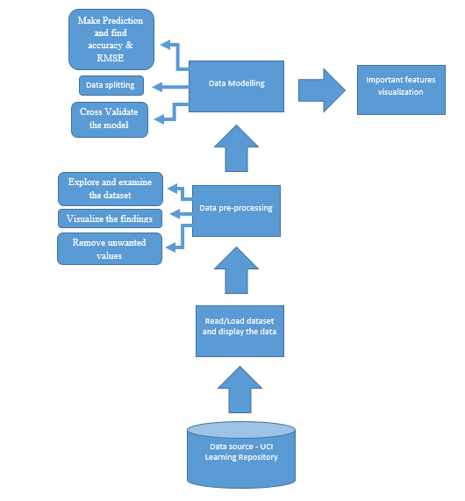
Detecting Parkinson’s Disease work-flow diagram
Fig 1.1: Workflow Diagram

Slide 5
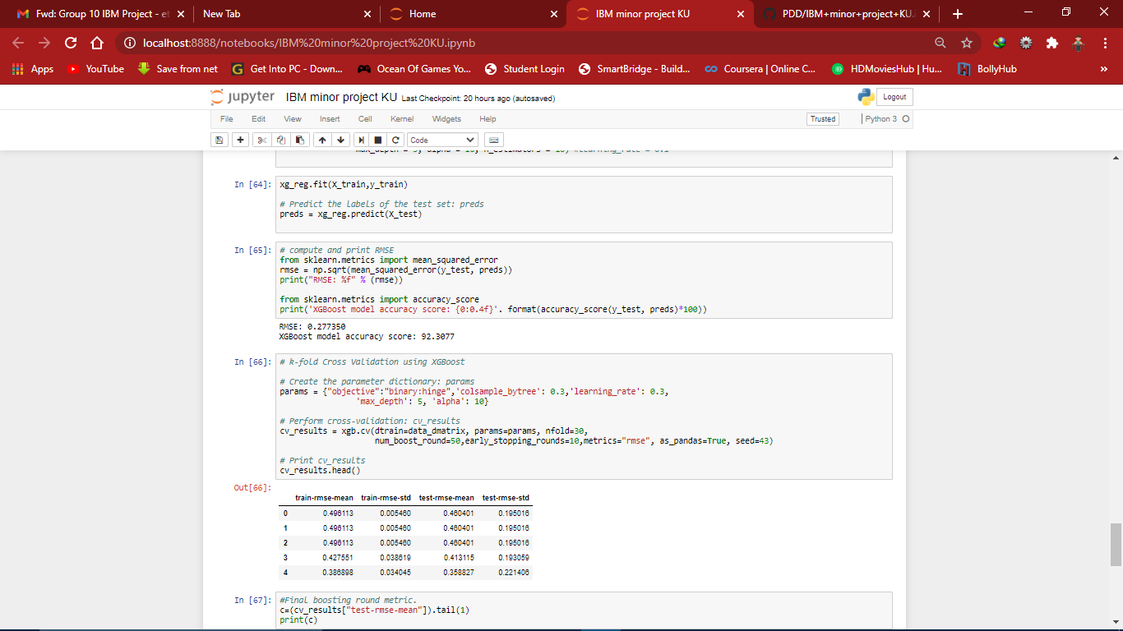
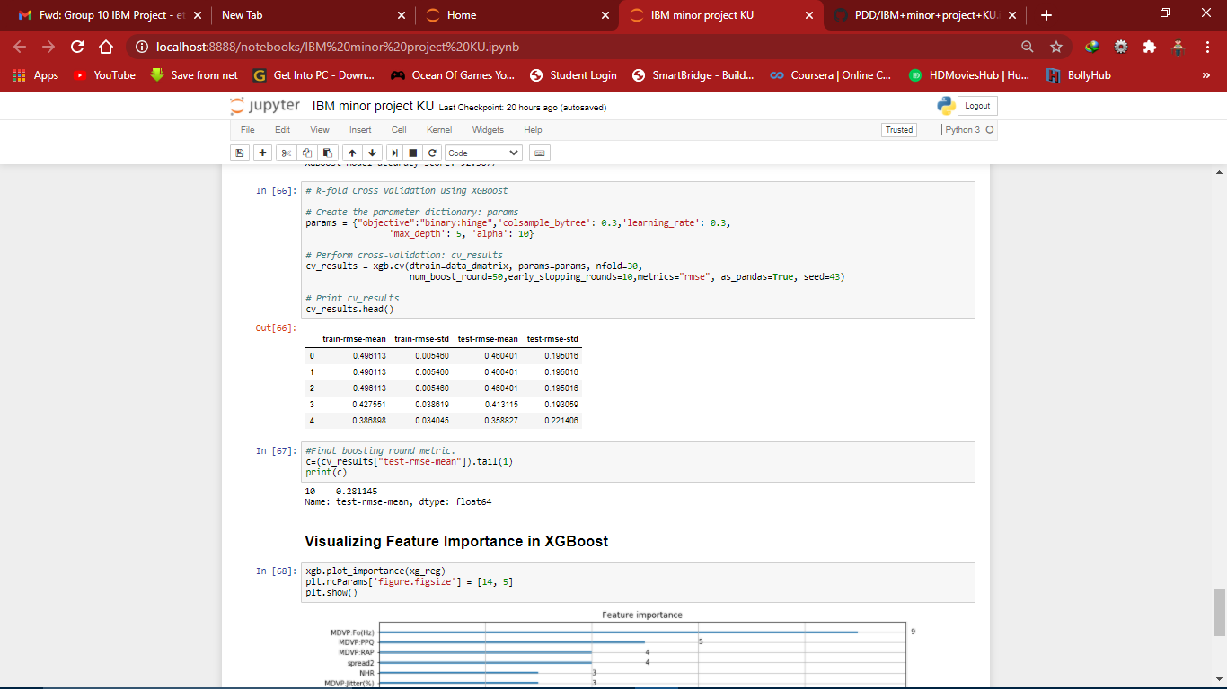
OUTPUT
An accuracy of 92.3077% was provided by the machine learning model with Root Mean Square Error of 0.277350.
On computing the k-fold cross validation of the model. The model gives Average Test RMSE of 0.281145, which is very close to the RMSE given by our model initially.
Screenshot 1.2: Accuracy and RMSE of the model
Screenshot 1.3: test-RMSE-mean of k-fold cross-validation

Slide 6
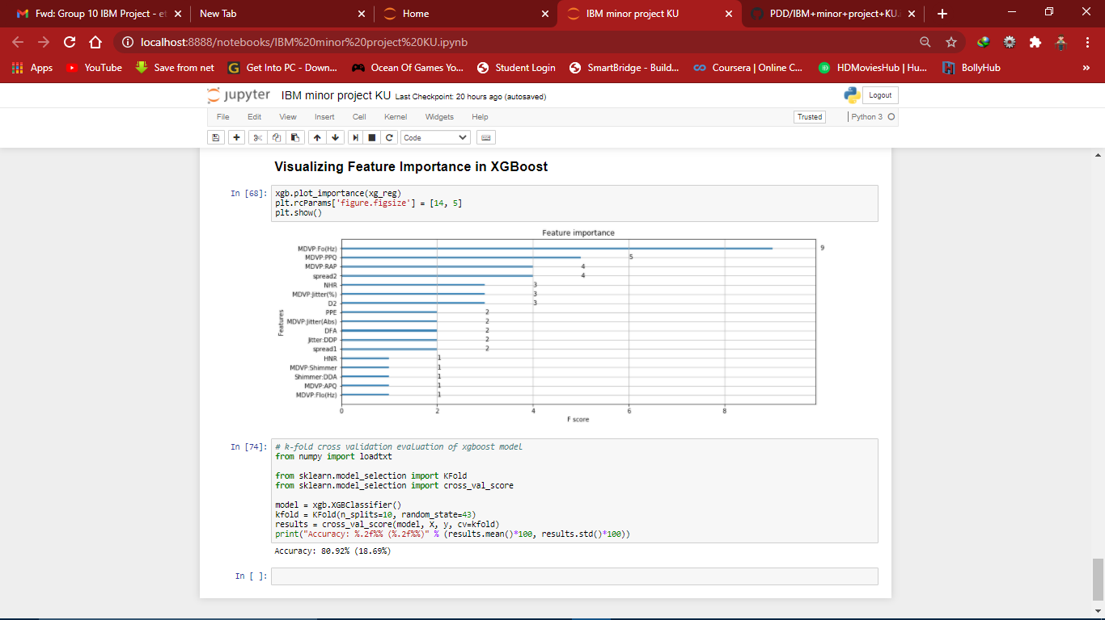
OUTPUT
Feature MDVP.Fo(Hz) (i.e. Average vocal fundamental frequency) has been given the highest importance score among all the features.
Screenshot 1.4: Feature-importance vs F-score

Slide 7
CONCLUSION & FUTURE SCOPE
The proposed model is a reliable model to detect Parkinson’s disease due to its efficient accuracy rates.
Though the model works efficiently, this is limited by the richness of the dataset with which it is being trained. The selected dataset, has only 197 instances, hence a dataset with more no of samples would help the model generalize better.

Slide 8
THANK YOU!

